Slide 1
Sleep Efficiency and Lifestyle Choices
COM SCI 450.2 · Individual Project Presentation
Ece Erke
Notes:
[Sources]
- Kaggle Sleep Efficiency Dataset: https://www.kaggle.com/datasets/equilibriumm/sleep-efficiency
- Analysis charts supplied by Ece Erke from the project R workflow.

Slide 2
Sleep Efficiency Dataset
Description of the Data
Found on: https://www.kaggle.com/datasets/equilibriumm/sleep-efficiency
Part of a study that investigated the impact of different lifestyle factors on sleep efficiency.
Original dataset: 452 rows and 15 columns.
Rows with NA values have been removed from 5 different columns.
Cleaned dataset used in this project: 388 rows, 13 columns.
Notes:
[Sources]
- Kaggle Sleep Efficiency Dataset: https://www.kaggle.com/datasets/equilibriumm/sleep-efficiency
- Analysis charts supplied by Ece Erke from the project R workflow.

Slide 3
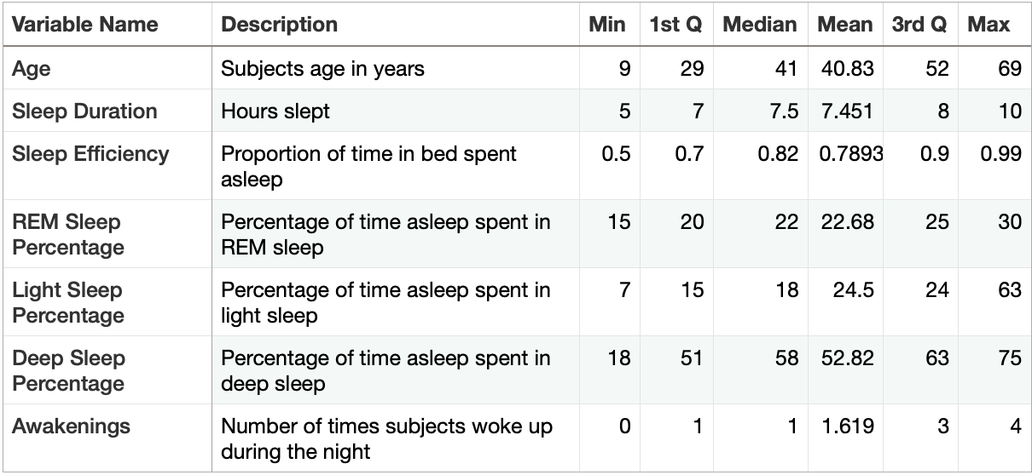
Sleep Efficiency Dataset
Description of the Variables (Numerical)
Notes:
[Sources]
- Kaggle Sleep Efficiency Dataset: https://www.kaggle.com/datasets/equilibriumm/sleep-efficiency
- Analysis charts supplied by Ece Erke from the project R workflow.

Slide 4
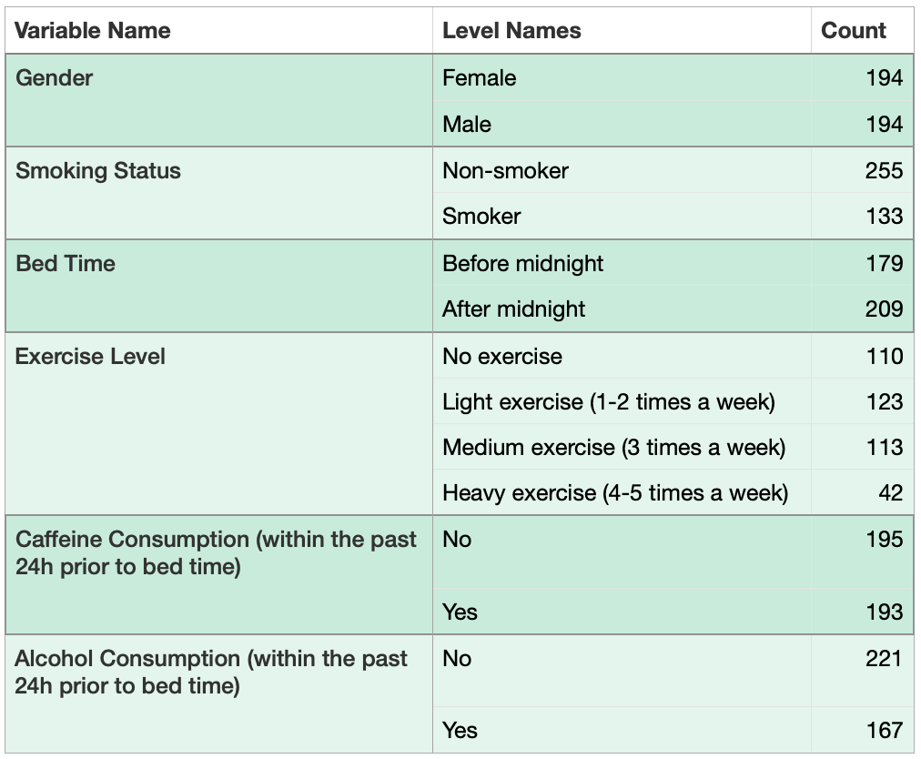
Sleep Efficiency Dataset
Description of the Variables (Categorical)
Notes:
[Sources]
- Kaggle Sleep Efficiency Dataset: https://www.kaggle.com/datasets/equilibriumm/sleep-efficiency
- Analysis charts supplied by Ece Erke from the project R workflow.

Slide 5
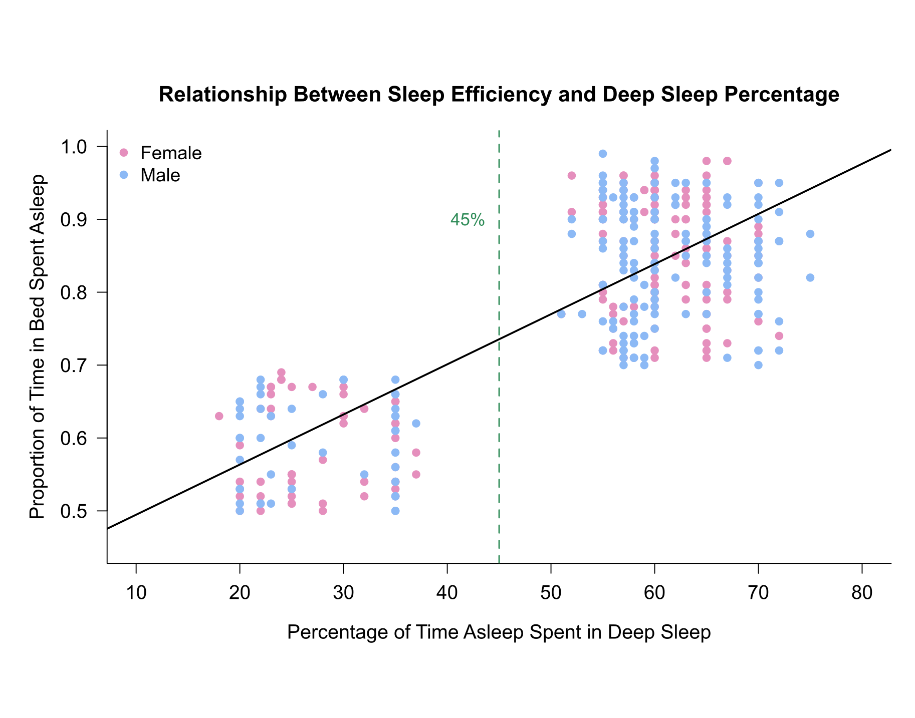
Regression Models
Sleep Efficiency by
Deep Sleep Percentage
Model: Sleep efficiency = 0.425998 + (0.006877 × Deep sleep percentage)
In this sample, a one-point increase in deep sleep percentage is associated with an estimated 0.006877 increase in sleep efficiency.
Higher deep-sleep percentages are associated with higher sleep efficiency.
Notes:
[Sources]
- Kaggle Sleep Efficiency Dataset: https://www.kaggle.com/datasets/equilibriumm/sleep-efficiency
- Analysis charts supplied by Ece Erke from the project R workflow.

Slide 6
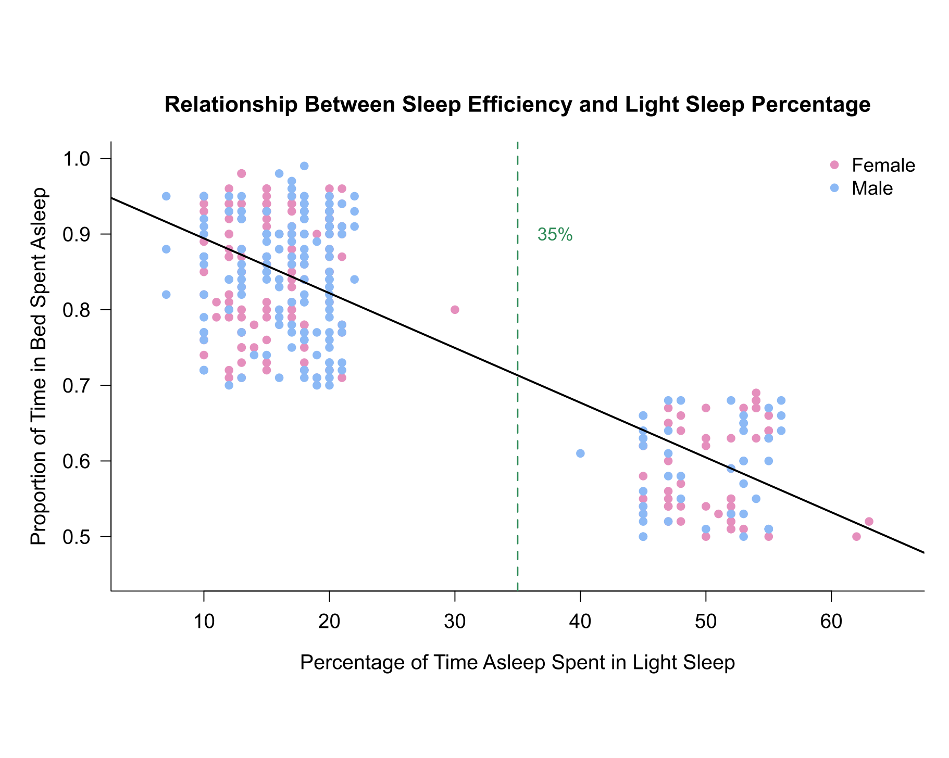
Regression Models
Sleep Efficiency by
Light Sleep Percentage
Model: Sleep efficiency = 0.966648 - (0.007241 × Light sleep percentage)
In this sample, a one-point increase in light sleep percentage is associated with an estimated 0.007241 decrease in sleep efficiency.
Higher light-sleep percentages are associated with lower sleep efficiency.
Notes:
[Sources]
- Kaggle Sleep Efficiency Dataset: https://www.kaggle.com/datasets/equilibriumm/sleep-efficiency
- Analysis charts supplied by Ece Erke from the project R workflow.

Slide 7
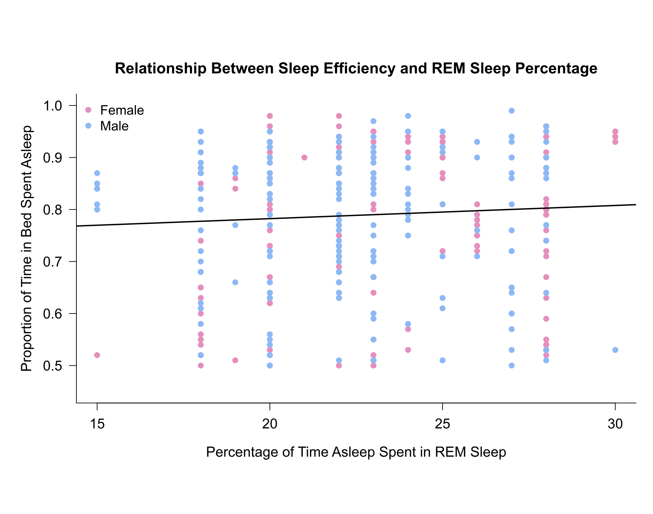
Regression Models
Sleep Efficiency by
REM Sleep Percentage
Model: Sleep efficiency = 0.731798 + (0.002533 × REM sleep percentage)
In this sample, REM sleep percentage does not show a statistically significant association with sleep efficiency.
The slight positive slope should be interpreted cautiously.
Notes:
[Sources]
- Kaggle Sleep Efficiency Dataset: https://www.kaggle.com/datasets/equilibriumm/sleep-efficiency
- Analysis charts supplied by Ece Erke from the project R workflow.

Slide 8
Regression Models Comparison
Comparing simple sleep-stage models of sleep efficiency
Deep Sleep: R² = 0.6217, p < .001
Light Sleep: R² = 0.6665, p < .001
REM Sleep: R² = 0.0015, p = .208
Light sleep shows the strongest simple association with sleep efficiency. Deep and light sleep are statistically significant in these simple models; REM sleep is not.
Notes:
[Sources]
- Kaggle Sleep Efficiency Dataset: https://www.kaggle.com/datasets/equilibriumm/sleep-efficiency
- Analysis charts supplied by Ece Erke from the project R workflow.

Slide 9
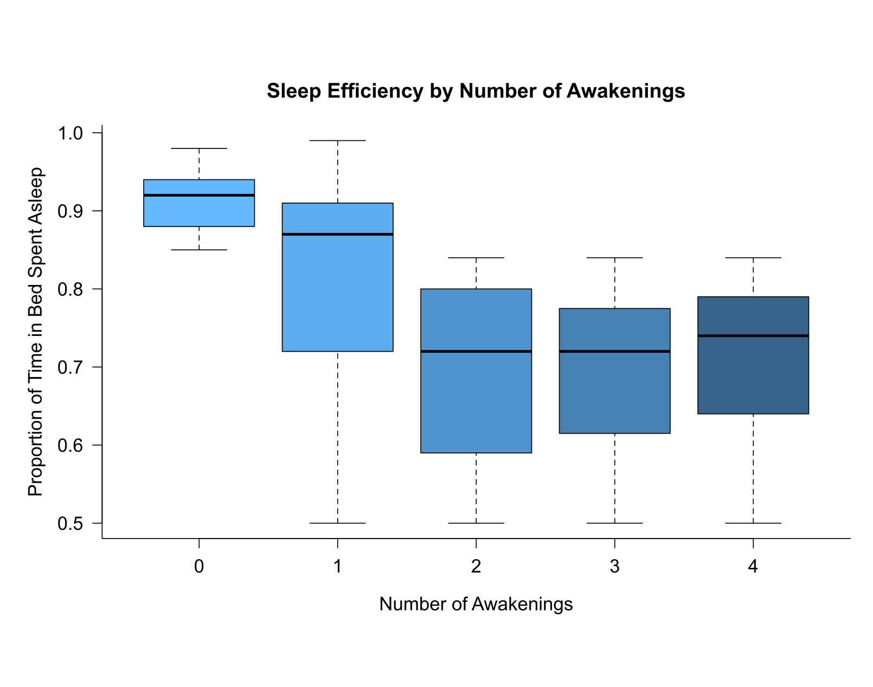
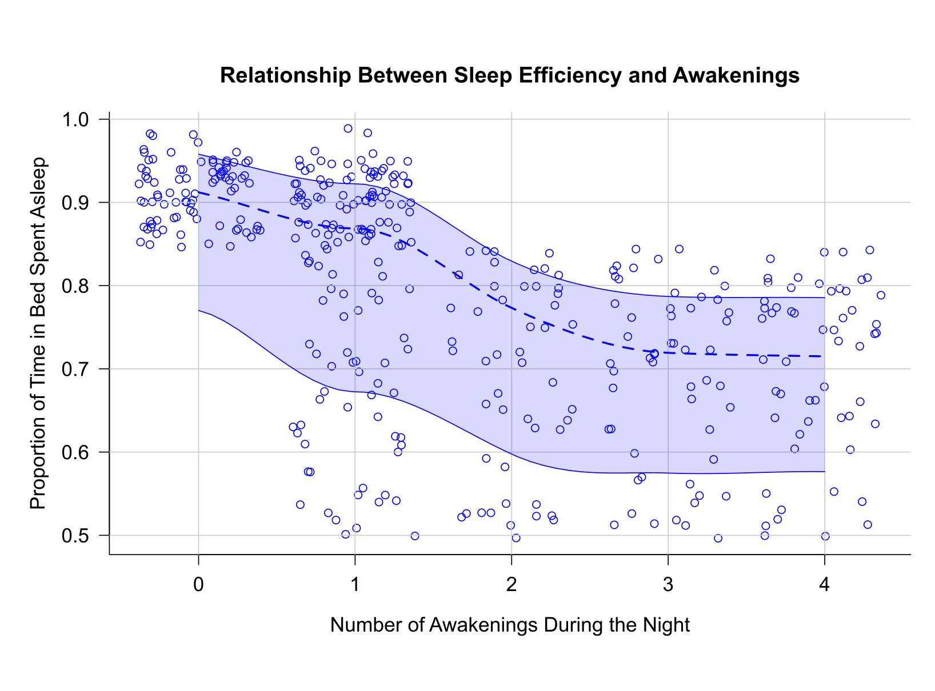
Awakenings & Sleep Efficiency
Notes:
[Sources]
- Kaggle Sleep Efficiency Dataset: https://www.kaggle.com/datasets/equilibriumm/sleep-efficiency
- Analysis charts supplied by Ece Erke from the project R workflow.

Slide 10
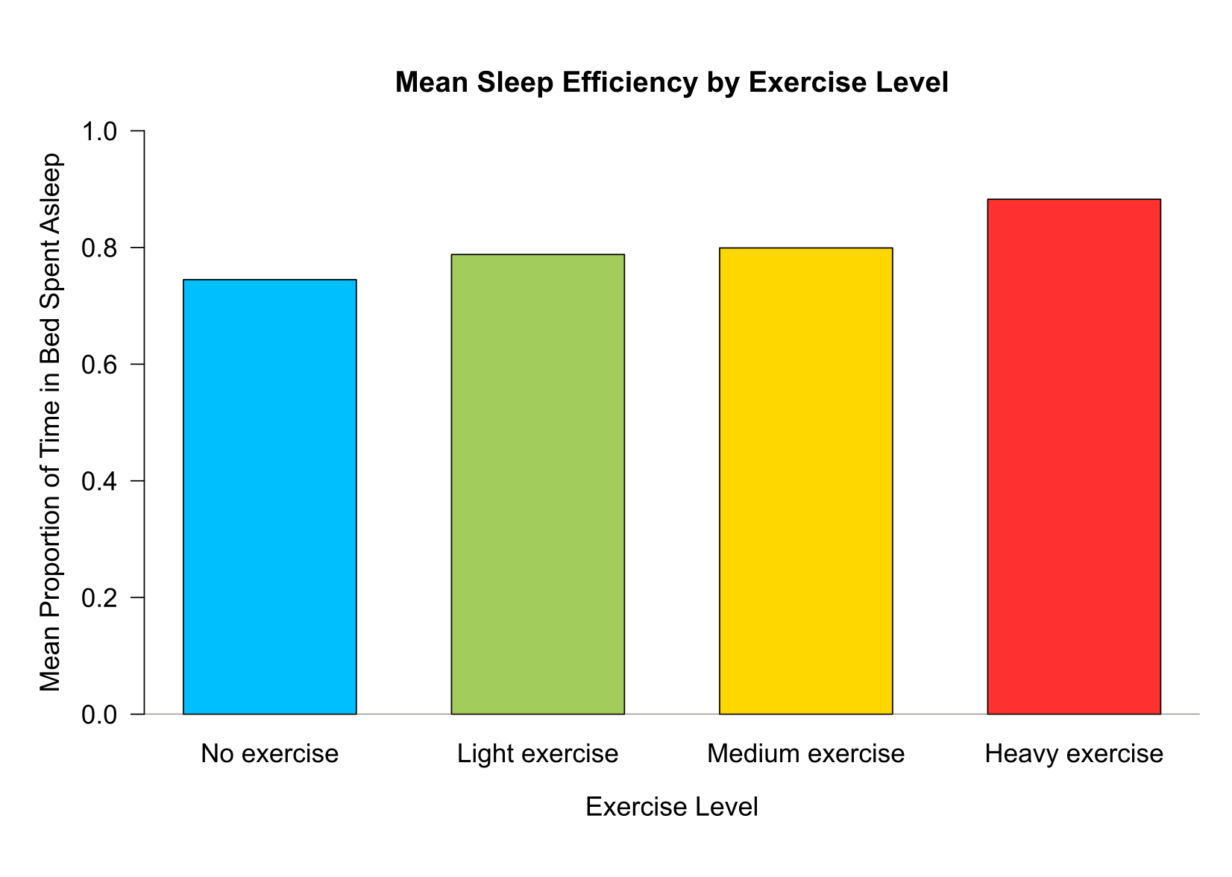
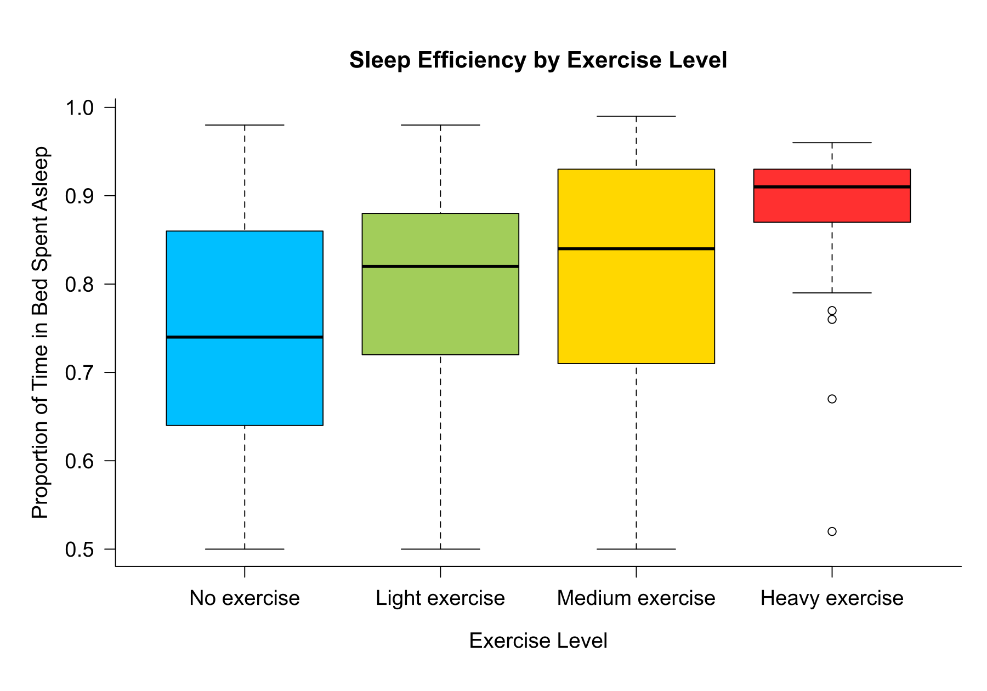
Exercise Level & Sleep
Effect on Sleep Efficiency
0.8826190
0.7448182
0.7879675
0.7992035
Notes:
[Sources]
- Kaggle Sleep Efficiency Dataset: https://www.kaggle.com/datasets/equilibriumm/sleep-efficiency
- Analysis charts supplied by Ece Erke from the project R workflow.

Slide 11
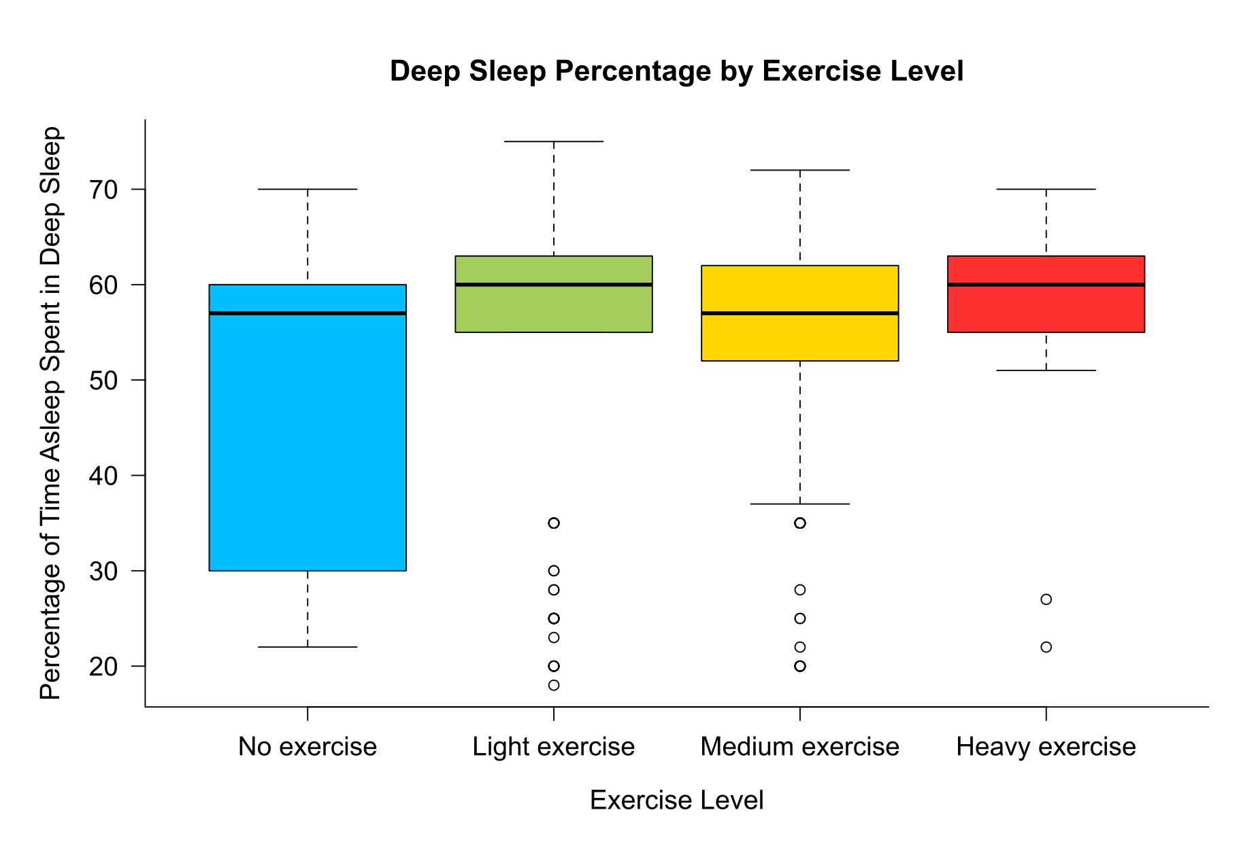
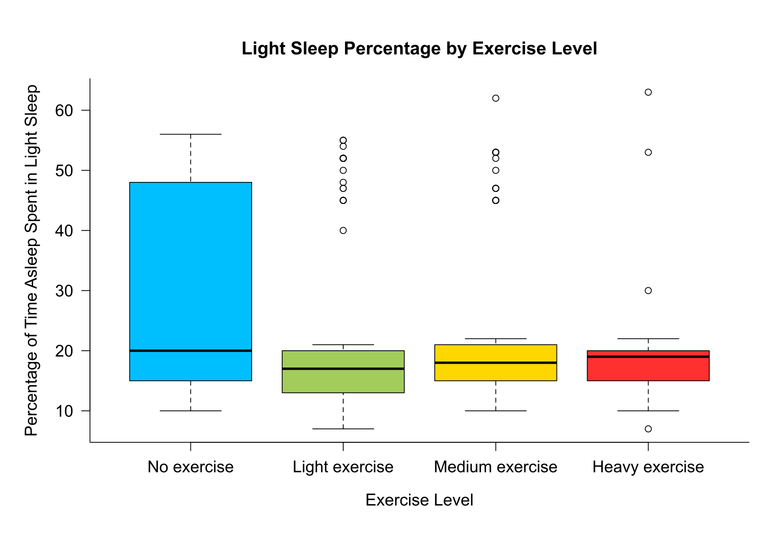
Exercise Level & Sleep
Effect on Different Sleep States
Notes:
[Sources]
- Kaggle Sleep Efficiency Dataset: https://www.kaggle.com/datasets/equilibriumm/sleep-efficiency
- Analysis charts supplied by Ece Erke from the project R workflow.

Slide 12
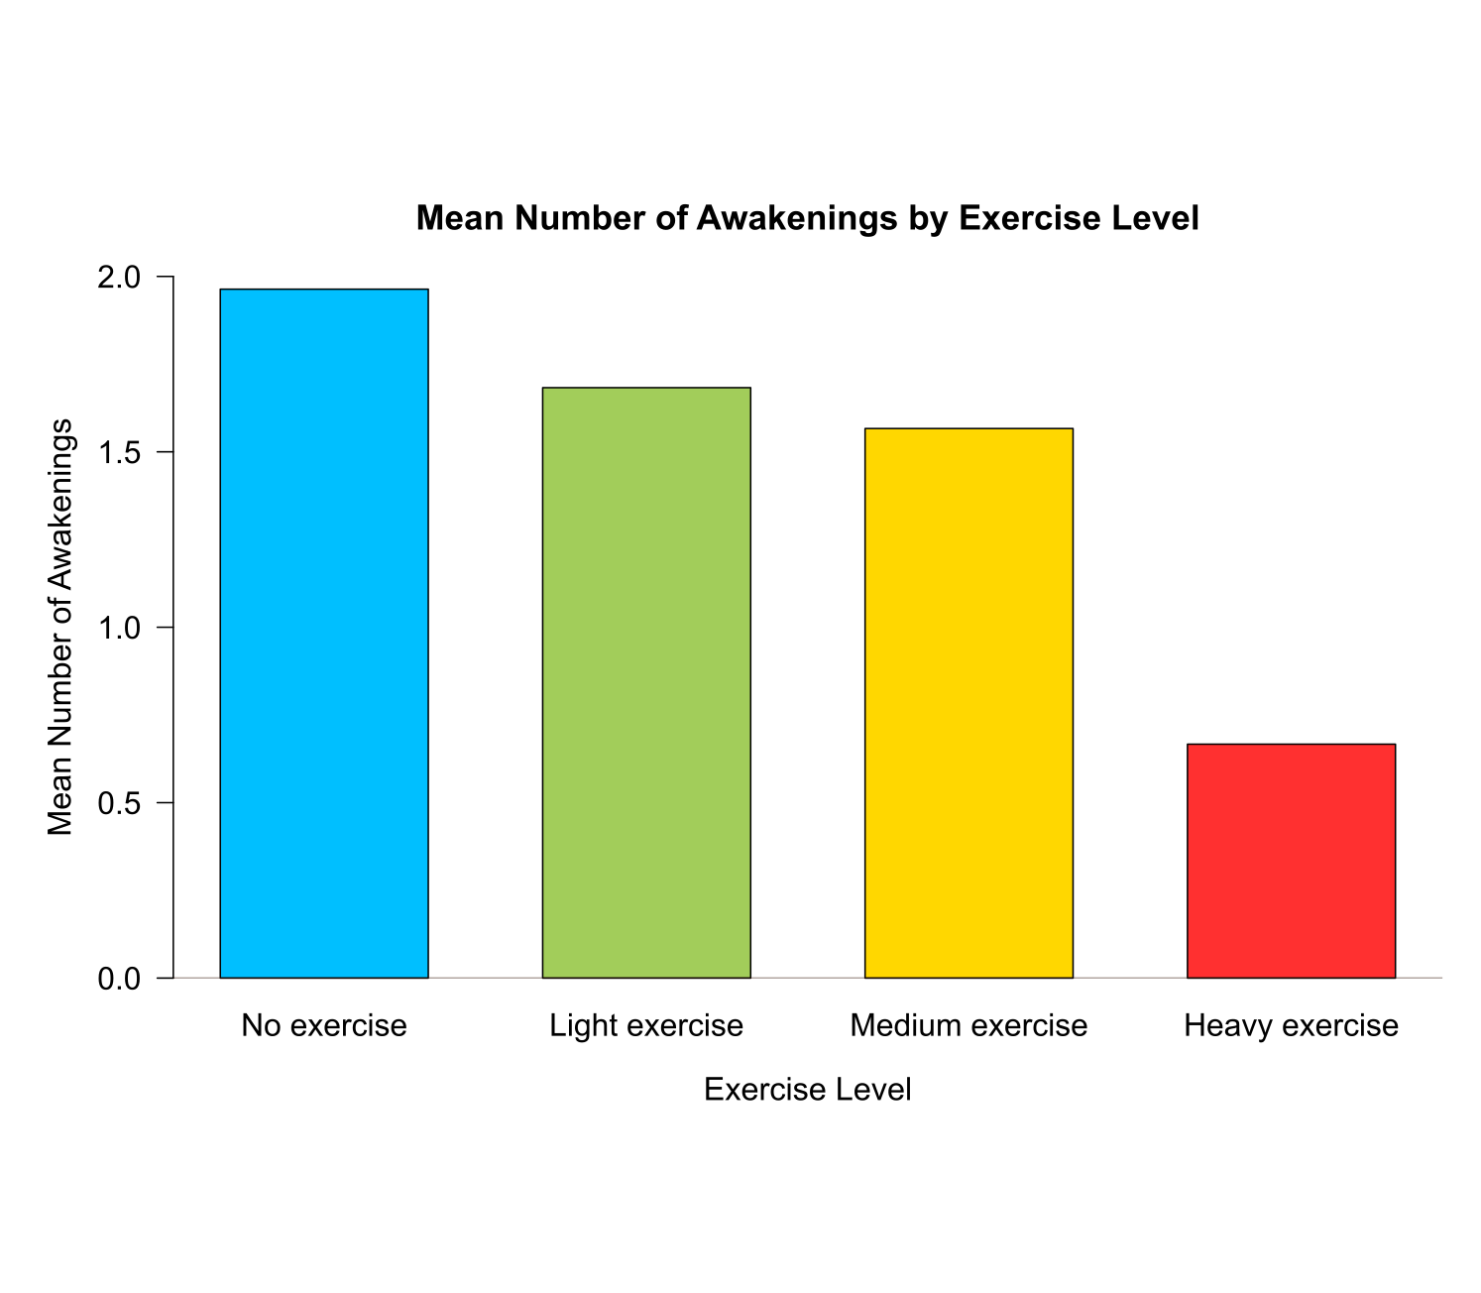
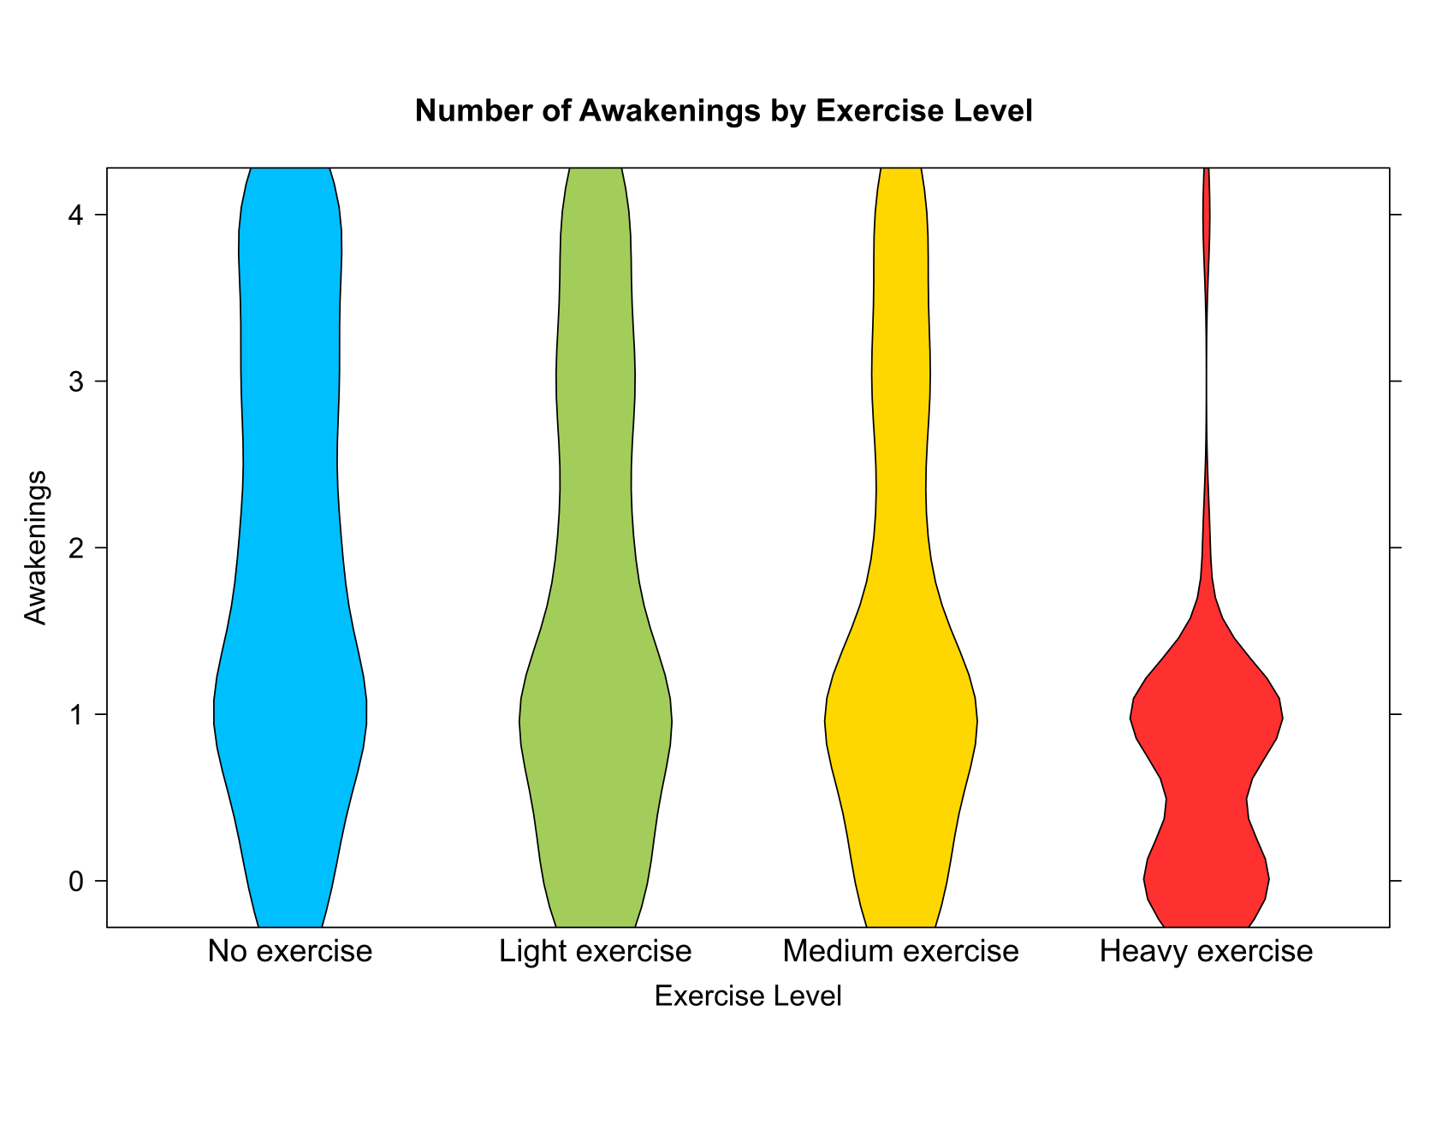
Exercise Level & Sleep
Effect on Awakenings
1.9636364
1.6829268
1.5663717
0.6666667
Notes:
[Sources]
- Kaggle Sleep Efficiency Dataset: https://www.kaggle.com/datasets/equilibriumm/sleep-efficiency
- Analysis charts supplied by Ece Erke from the project R workflow.

Slide 13
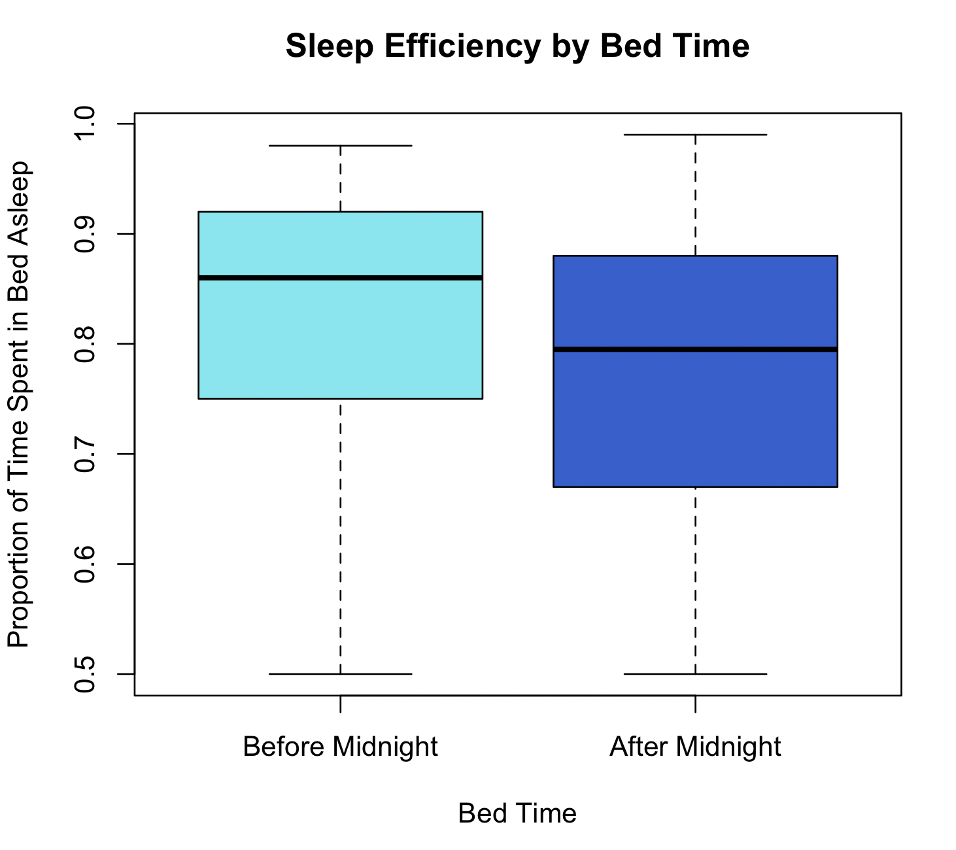
Bedtime & Sleep Efficiency
Notes:
[Sources]
- Kaggle Sleep Efficiency Dataset: https://www.kaggle.com/datasets/equilibriumm/sleep-efficiency
- Analysis charts supplied by Ece Erke from the project R workflow.

Slide 14
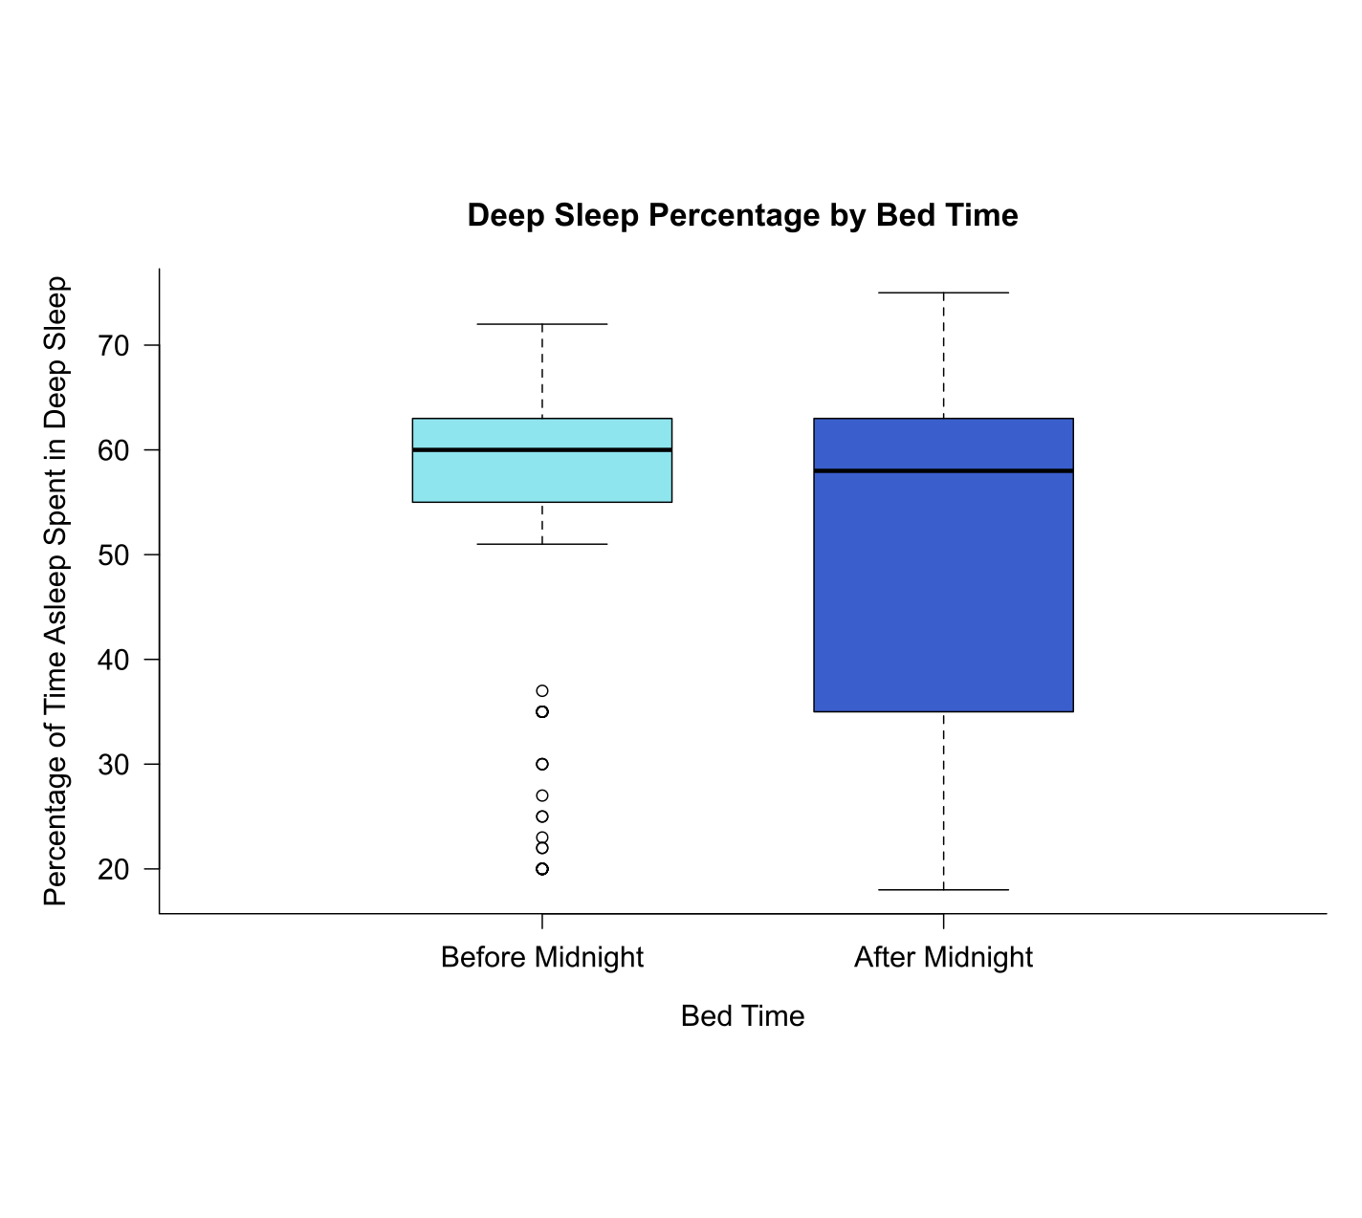
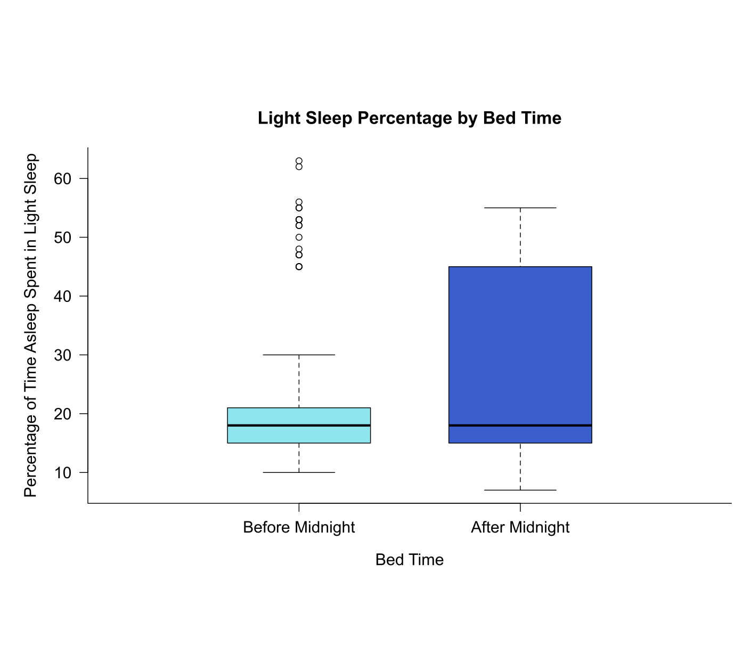
Bedtime & Sleep Stages
Notes:
[Sources]
- Kaggle Sleep Efficiency Dataset: https://www.kaggle.com/datasets/equilibriumm/sleep-efficiency
- Analysis charts supplied by Ece Erke from the project R workflow.

Slide 15
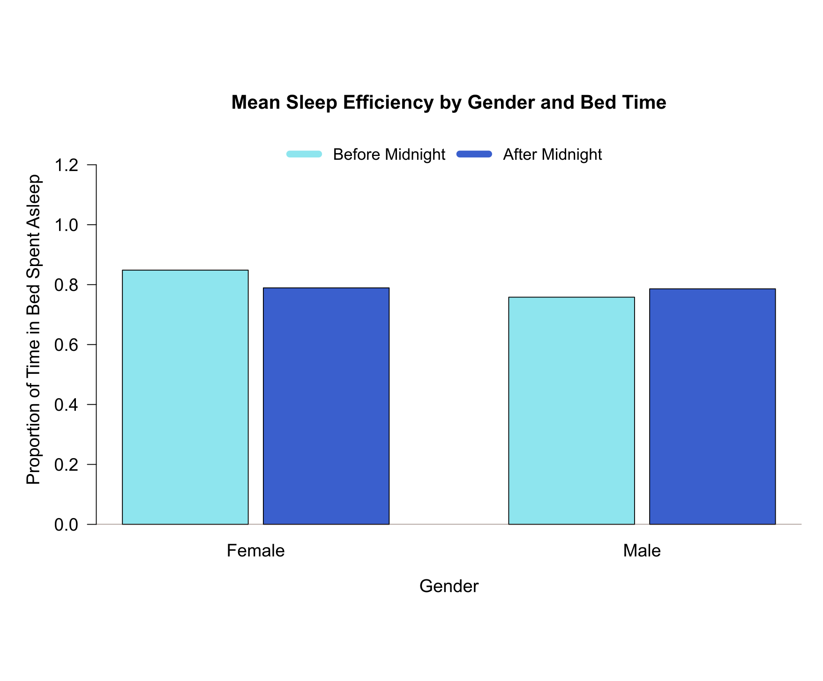
Bedtime & Gender
0.8484146
0.7580952
0.7892000
0.7860417
Notes:
[Sources]
- Kaggle Sleep Efficiency Dataset: https://www.kaggle.com/datasets/equilibriumm/sleep-efficiency
- Analysis charts supplied by Ece Erke from the project R workflow.

Slide 16
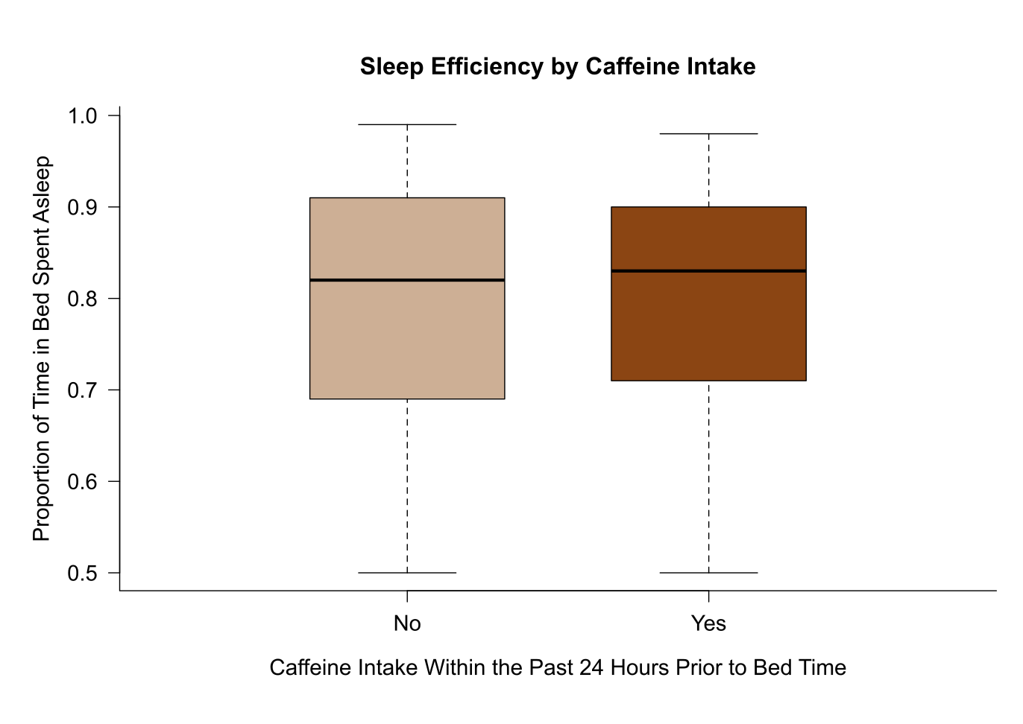
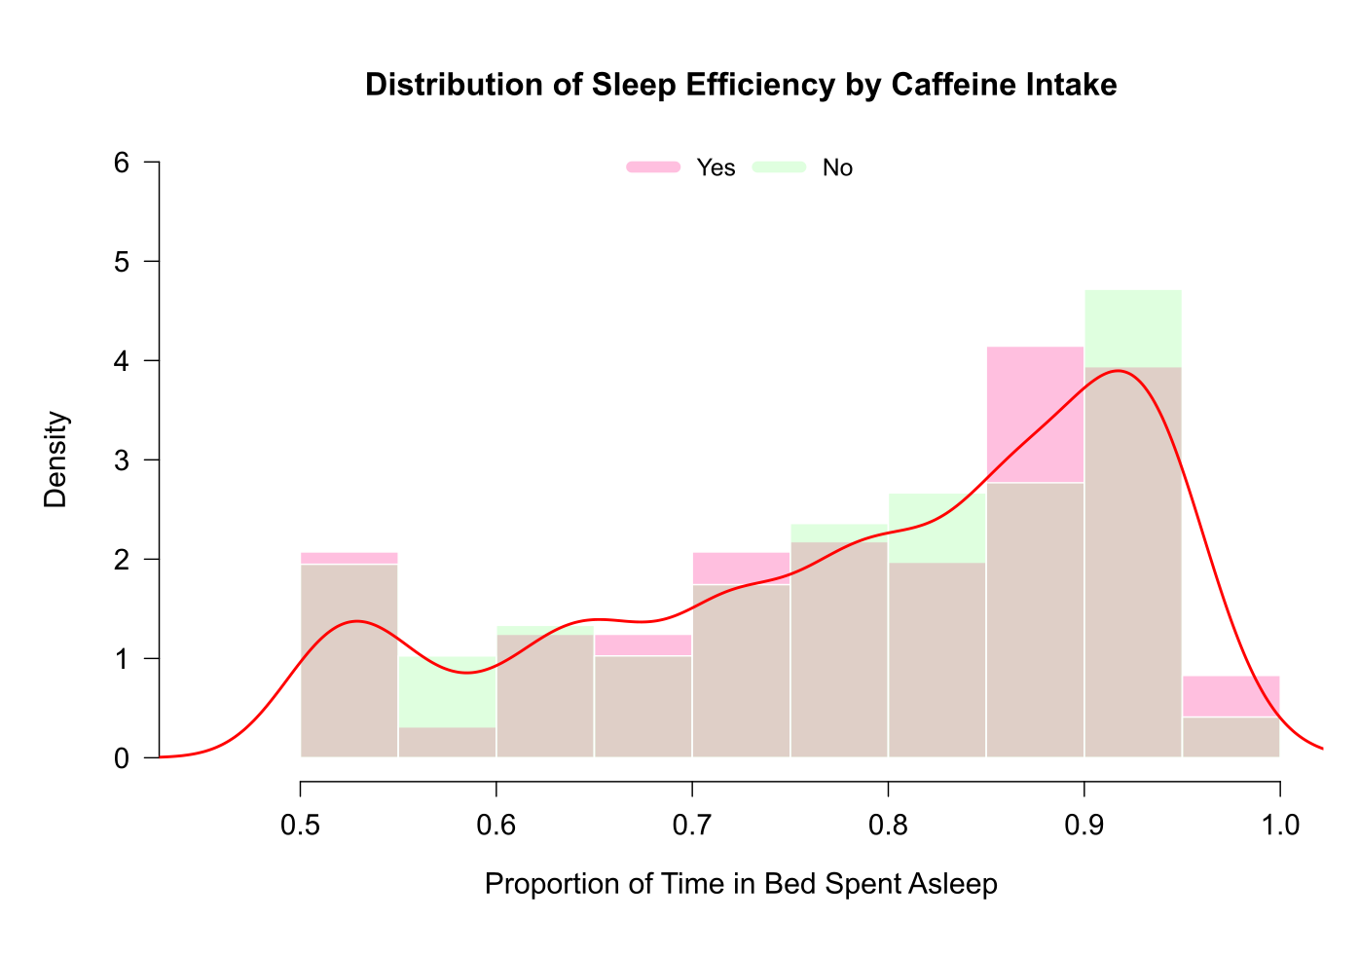
Caffeine & Sleep
Specifically, caffeine intake within the 24 hours prior to bed time
Notes:
[Sources]
- Kaggle Sleep Efficiency Dataset: https://www.kaggle.com/datasets/equilibriumm/sleep-efficiency
- Analysis charts supplied by Ece Erke from the project R workflow.

Slide 17
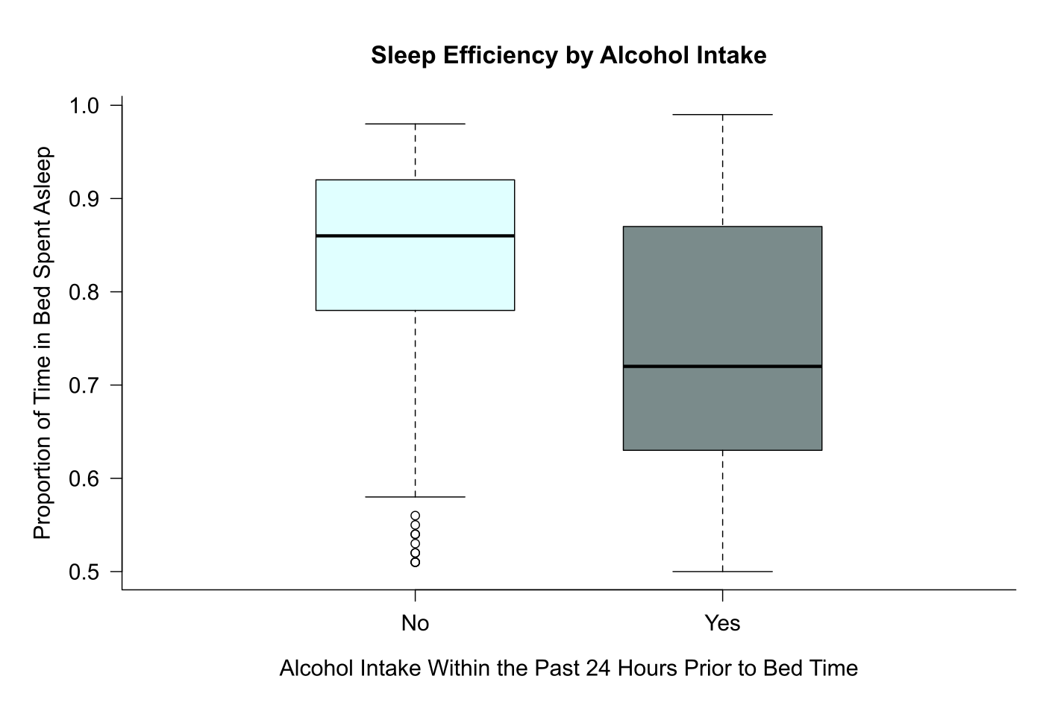
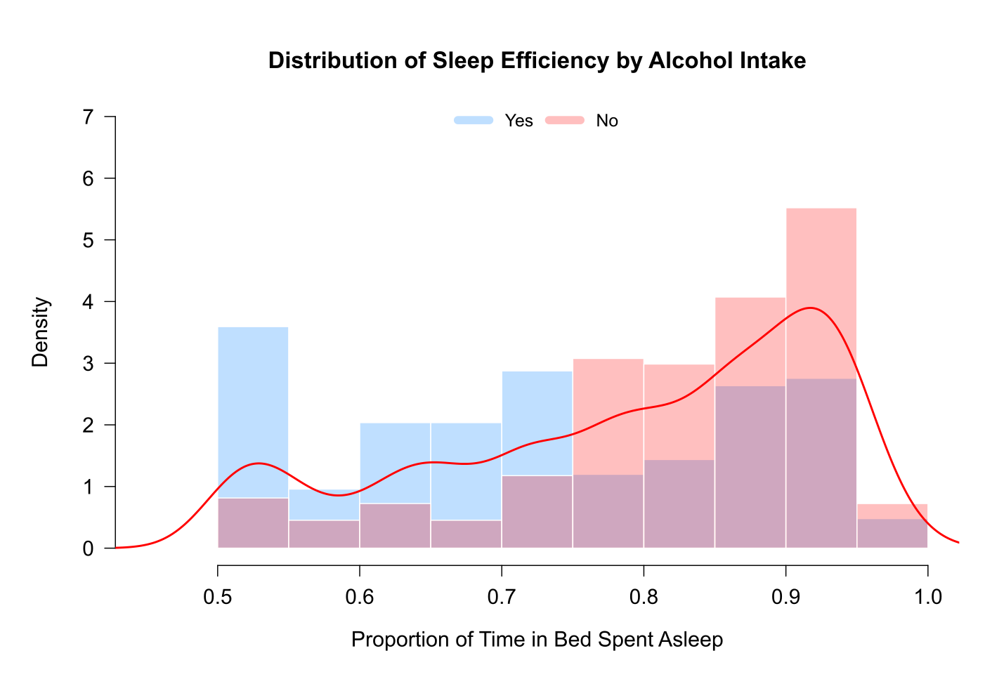
Alcohol & Sleep
Specifically, alcohol intake within the 24 hours prior to bed time
Notes:
[Sources]
- Kaggle Sleep Efficiency Dataset: https://www.kaggle.com/datasets/equilibriumm/sleep-efficiency
- Analysis charts supplied by Ece Erke from the project R workflow.

Slide 18
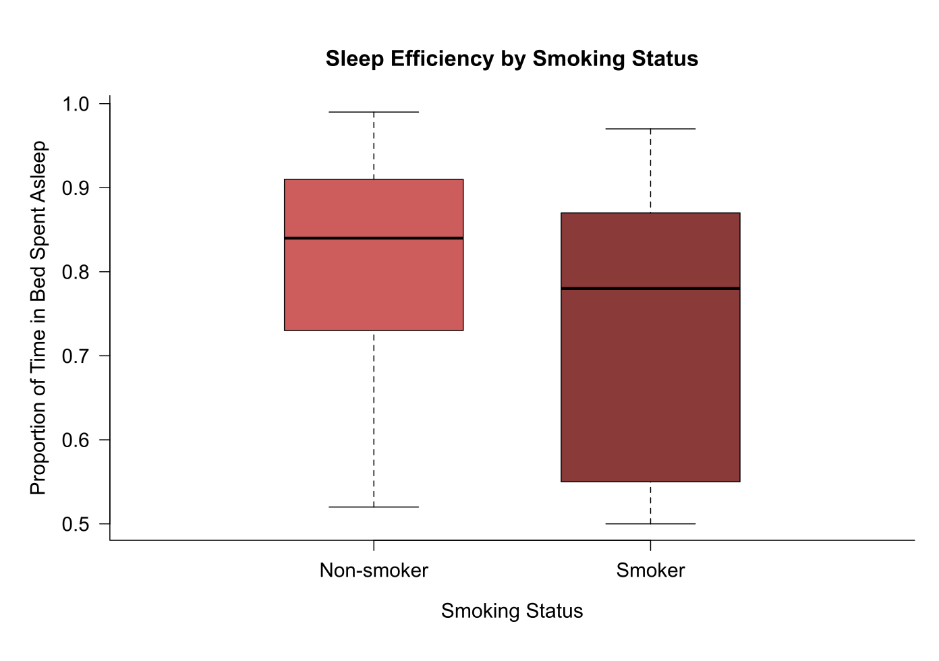
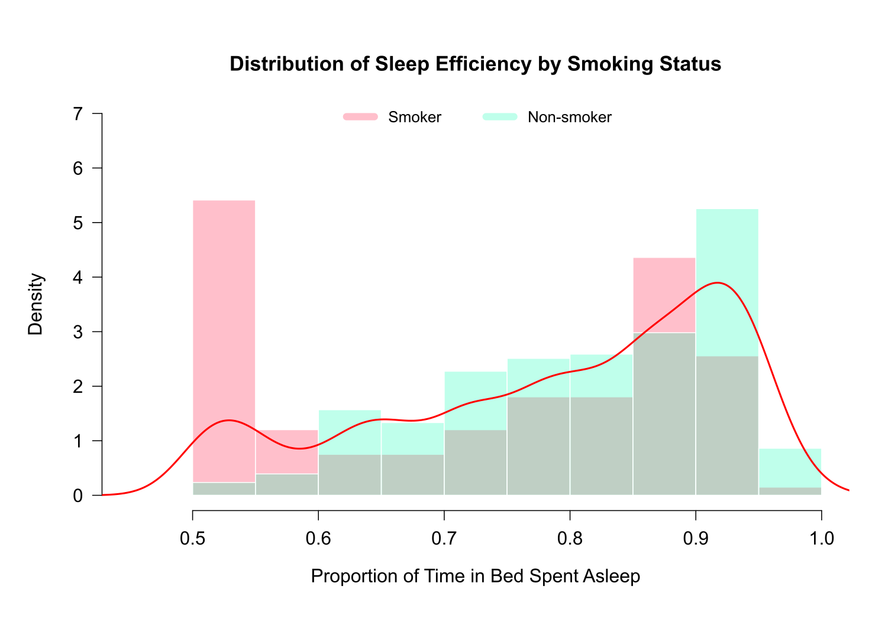
Smoking & Sleep
Levels: Smoker and Non-smoker
Notes:
[Sources]
- Kaggle Sleep Efficiency Dataset: https://www.kaggle.com/datasets/equilibriumm/sleep-efficiency
- Analysis charts supplied by Ece Erke from the project R workflow.

Slide 19
Conclusions
Higher deep-sleep percentage and lower light-sleep percentage were associated with higher sleep efficiency; REM sleep showed no meaningful relationship.
Participants with fewer nighttime awakenings tended to show higher sleep efficiency.
Higher exercise frequency was associated with higher sleep efficiency in this sample.
Going to bed before midnight was associated with slightly higher sleep efficiency for females in this dataset.
Caffeine showed no clear difference, while alcohol use and smoking were associated with lower sleep efficiency.
Notes:
[Sources]
- Kaggle Sleep Efficiency Dataset: https://www.kaggle.com/datasets/equilibriumm/sleep-efficiency
- Analysis charts supplied by Ece Erke from the project R workflow.

